Slide 1
Unit-4, MBA-104
Dr. Bharti Shukla
Assistant Professor
Department of Management Studies
MMMUT, GKP

Slide 2
PROMOTION IN MARKETING
Marketing of Infrastructure Services and Utilities
Module 6
Promotion
How do we make customers aware about the product
How do we communicate?
Problem of integrated marketing communications
What is the communication process

Slide 3
Marketing Communications
Marketing of Infrastructure Services and Utilities
Module 6
Direct Marketing
Advertising
Sales Promotion
Public Relations
Personal Selling

Slide 4
PROMOTION IN MARKETING
Marketing of Infrastructure Services and Utilities
Module 6
Communication process
Interactive process
Between company and its customers
Every aspect communicates
Product styling
Price
Packaging
Shape, colour
Sales personnel dress and manners
Channel partners behaviour
Office décor
Sales personnel business card
Stationery

Slide 5
PROMOTION IN MARKETING
Marketing of Infrastructure Services and Utilities
Module 6
Example
Customer wants to buy computers. What will he do?
Talk to others
See ads on television
Read articles
Surf internet
Go to computer shop
See a live demonstration
Marketers need to understand which experiences and impressions will have the most influence at each stage of the buying process.

Slide 6
Marketing of Infrastructure Services and Utilities
Module 6
Steps in Developing Effective Communication

Slide 7
PROMOTION IN MARKETING
Marketing of Infrastructure Services and Utilities
Module 6
1. Advertising
Any paid form of non personal presentation and promotion of ideas, goods or services by an identified sponsor
Is done by
Commercial organizations
Government
Non-profit organizations
Direct messages to target public

Slide 8
PROMOTION IN MARKETING
Marketing of Infrastructure Services and Utilities
Module 6
Advertising can be used to
Long term image
Image positioning
2. Trigger quick sales
Buy one, get one free
3. Geographically dispersed buyers
Lifebuoy customers o Rural
Semi-urban
All over India
4. Brand preference
Surf comparing ordinary washing powder with surf

Slide 9
PROMOTION IN MARKETING
Marketing of Infrastructure Services and Utilities
Module 6
Removing misconceptions
Present right picture

Slide 10
PROMOTION IN MARKETING
Marketing of Infrastructure Services and Utilities
Module 6
Who carries out advertising?
Advertising department within the marketing department
Most of the work carried out by an outside advertising agency

Slide 11
Marketing of Infrastructure Services and Utilities
Module 6
The Five Ms of Advertising

Slide 12
PROMOTION IN MARKETING
Marketing of Infrastructure Services and Utilities
Module 6
2. Sales promotion
Consists of a diverse collection of incentive tools, mostly short term, designed to stimulate quicker or greater purchase of particular products or services by consumers or the trade.

Slide 13
PROMOTION IN MARKETING
Marketing of Infrastructure Services and Utilities
Module 6
Sales promotion
Whereas advertising offers a reason to buy, sales
promotion offers an incentive to buy.
Examples
Samples
Cash refund
Prices off
Prizes
Free trials
Cross – promotions

Slide 14
PROMOTION IN MARKETING
Marketing of Infrastructure Services and Utilities
Module 6
Types of sales promotion
Consumer promotion
- Targeted on end consumers
Trade promotion
Targeted on intermediaries and channel partners
Business promotion
Targeted on business / institutional consumers

Slide 15
PROMOTION IN MARKETING
Marketing of Infrastructure Services and Utilities
Module 6
Purposes of sales promotion
Introducing new Services product
Overcoming seasonal Fluctuation
Getting new accounts
Retrieving lost accounts
As a support and supplement to the advertising effort
As a supplement and support to the salesmen’s effort
Persuading marketing channel to buy more / increase the size of the orders.

Slide 16
PROMOTION IN MARKETING
Marketing of Infrastructure Services and Utilities
Module 6
3. Public relations (PR)
Involves a variety of programs designed to promote or protect a company’s image or its individual services product

Slide 17
Function of PR
Press relations
Presenting news and information about the organization in most positive light
Service Product publicity
Sponsoring efforts to publicize specific services products
Corporate communication
Promoting understanding of the organization through internal and external communications
Lobbying
Dealing with legislators and government officials to promote or defeat legislation and regulation
Counselling
Advising management about public issues and company positions and image. This includes in the event of a product mishap.

Slide 18
PROMOTION IN MARKETING
Marketing of Infrastructure Services and Utilities
Module 6
4. Personal selling
Face – to –face interaction with one or more prospective purchasers for the purpose of making presentations, answering questions and procuring orders

Slide 19
PROMOTION IN MARKETING
Marketing of Infrastructure Services and Utilities
Module 6
Personal selling
Is the most effective tool at later stages of the buying process.
Particularly in building up o Buyer preference
Conviction
Action

Slide 20
PROMOTION IN MARKETING
Marketing of Infrastructure Services and Utilities
Module 6
Personal selling
Three distinctive qualities
Personal confrontation
Immediate and interactive relationship between two or more persons
Cultivation
Encourages personal relationship
Informal
Response
Buyer under obligation
Listen to sales talk

Slide 21
PROMOTION IN MARKETING
Marketing of Infrastructure Services and Utilities
Module 6
5. Direct marketing
- Is an interactive marketing system that uses or one or more advertising media to effect a measurable response and/or transaction at any location

Slide 22
PROMOTION IN MARKETING
Marketing of Infrastructure Services and Utilities
Module 6
Direct marketing – characteristics
Non public
Message is addressed to a specific person
Customized
Message can be prepared to appeal to the addressed individual
Up-to-date
A message can be prepared very quickly
Interactive
The message can be changed depending on the
person’s response.

Slide 23
PROMOTION IN MARKETING
Marketing of Infrastructure Services and Utilities
Module 6
Major channels for direct marketing
Face – to – face selling
Direct mail
Catalogue marketing
Telemarketing
On-line marketing

Slide 24
Guide line for improving Promotion of Service
Use Clear , Unambiguous Message
Emphasise the benefits of services
Only Promise what can be delivered
Advertise to employee
Obtain and Maintain customer cooperation in the service Production Process
Build on word of mouth communication
Provide tangible clues
Develop continuity in advertising
Remove post purchase anxiety
Brand Building
Proper training of customers

Slide 25
Green Marketing
Green marketing is the marketing of products that are presumed to be environmentally safe. It incorporates a broad range of activities, including product modification, changes to the production process, sustainable packaging, as well as modifying advertising. Yet defining green marketing is not a simple task where several meanings intersect and contradict each other; an example of this will be the existence of varying social, environmental and retail definitions attached to this term. Other similar terms used are environmental marketing and ecological marketing.

Slide 26
Green Marketing Methods/ Strategies
Using eco-friendly paper and inks for print marketing materials
Skipping the printed materials altogether and option for electronic marketing
Having a recycling program and responsible waste disposal practices
Using eco-friendly product packaging
Using efficient packing and shipping methods
Using eco-friendly power sources
Taking steps to offset environmental impact

Slide 27
“Greenwashing”
Some marketers try to capitalize on the growing number of green consumers by simply taking a green marketing approach to products that might not otherwise be considered green.
They try to position their products as a better choice for the environment when they’re really not. An example of this is when a company uses the color green in their packaging, or the word green somewhere in their messaging, when there isn’t anything particularly eco-friendly about their product, nor it’s not more eco-friendly than competing products.
Greenwashing is not only misleading, but it can also be damaging to a company’s reputation.

Slide 28
Niche Marketing
Niche marketing is a targeted marketing plan that centers on a specific portion of the market that possesses a higher potential in connecting with a given product or service offered. This allows a brand to zero in on strategically selected channels and media platforms that can help the company reach its respected audience at a better rate. Here, marketers tailor their marketing strategies according to a predicted response.

Slide 29
Few Sectors for Niche Marketing
Computers
Music
Fashion
Engineering firms
Travel and Tourism
Health and Fitness

Slide 30
Common Niche Marketing Strategies
Word-of-Mouth Campaigns
(This subtle approach to marketing focuses more on the conversations made among consumers. Unlike most advertising materials, brand exposure in this type of campaign is relatively low key)
Targeted Collateral Campaigns
(For this type of marketing strategy, consistent brand exposure is highly prioritized. For example, radio stations often play a niche genre of music to cater to a specific group of listeners)
Trusted-Messenger/Endorsement Campaigns
(In an attempt to reach optimum market impact, many businesses utilize various celebrity marketing strategies to appeal to consumers. These endorsements often generate a lot of attention due to the collaborations made with these personalities and influencers.)

Slide 31
Guerilla marketing
Guerilla marketing is a set of marketing actions employed to launch a marketing campaign at a fraction of the price it would typically cost.
The impact should be, of course, more significant regardless of the low budget invested in it.
In other words, guerrilla marketing acts as a magnifying glass for the impact of a marketing campaign.

Slide 32
Street Marketing Street marketing is the more recently coined term for the outdoor guerrilla marketing type.

Slide 33
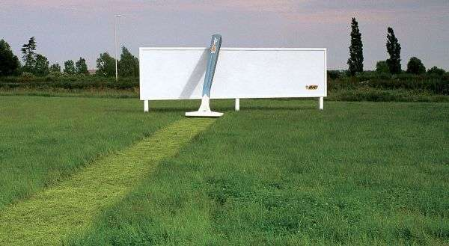
Ambient Marketing
With this creative marketing campaign, BIC makes a HUGE statement:
“Our razors are sharp enough to mow your lawn!”
This type refers to marketing practices that help promote a product by interfering with the flow of things.
A common practice is when brands place ads at unconventional places to increase brand awareness creatively.

Slide 34
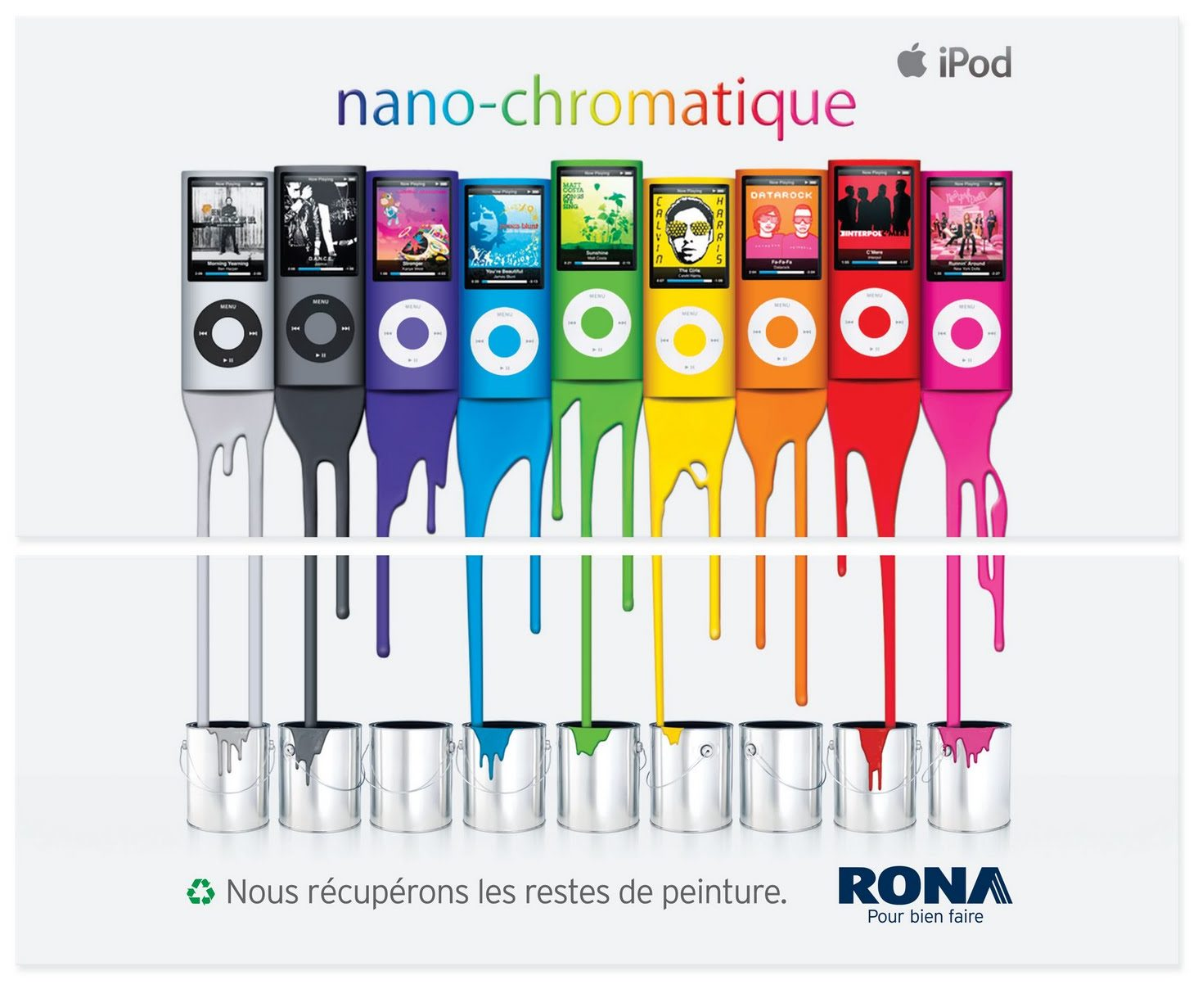
Ambush Marketing
Event ambush marketing is when marketers take advantage of the audience of an event and use it to promote their product or service.
Here’s all-time favorite guerrilla marketing example from Rona:

Slide 35
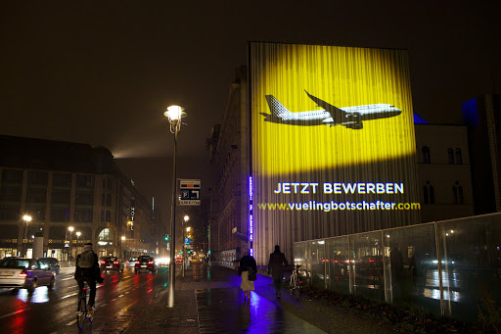
Guerrilla Projections
This form of marketing involves mastering the installation of hidden projectors onto high-rise buildings at high-traffic streets to generate buzz.
For retail stores, this practice will generate additional foot traffic and increase brand awareness.
Vueling, for instance, uses this simple guerrilla advertising campaign to intrigue passers-by.

Slide 36
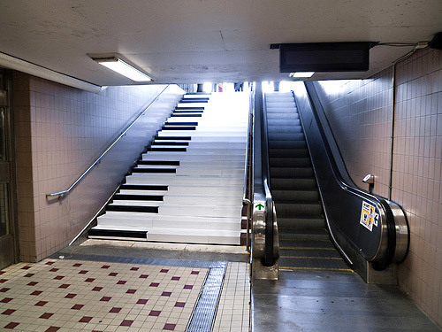
Experiential Marketing
This incredible guerrilla marketing idea is also known as participation marketing or live marketing.
Experiential marketing entails the creation of immersive, pop-up experiences that invite users to “talk, live, breathe” the brand.
For Volkswagen, a major automobile company, its unforgettable interactive piano campaign was a major hit.

