Slide 1
Unit-3, Marketing Management
Dr. Bharti Shukla
Assistant Professor
Department of Management Studies
MMMUT, GKP

Slide 2
Concept and Meaning of Price and Pricing
🠶 A price is the amount one pays for a good or a service or an idea. Price is the amount for which a product, a service or an idea is exchanged, or offered for sale regardless of its worth or value, to the potential purchaser. Without price there is no marketing, in the society. To a manufacturer, price represents quantity of money (or goods and services in a barter trade) received by the firm or seller. To a customer, it represents sacrifice and hence his perception of the value of the product.
🠶 The term ‘price’ needs not be confused with the term ‘pricing’. Pricing is the art of translating into quantitative terms (say rupees or dollars) the value of the product or a unit of a service to customers at a point in time.

Slide 3
🠶 Pricing the product or service is one of the most important business decisions you will make.
🠶 You must offer your products for a price your target market is willing to pay
– and one that produces a profit for your company – or you won’t be in
business for long.
🠶 According to Prof. K.C. Kite,
🠶 “Pricing is a managerial task that involves establishing pricing objectives, identifying the factors governing the price, ascertaining their relevance and significance, determining the product value in monetary terms and formulation of price policies and the strategies, implementing them and controlling them for the best results”.

Slide 4
Pricing - Factors affecting pricing
A. Internal Factors:
Cost:
While fixing the prices of a product, the firm should consider the cost involved in producing the product. This cost includes both the variable and fixed costs. Thus, while fixing the prices, the firm must be able to recover both the variable and fixed costs.
The predetermined objectives:
While fixing the prices of the product, the marketer should consider the objectives of the firm. For instance, if the objective of a firm is to increase return on investment, then it may charge a higher price, and if the objective is to capture a large market share, then it may charge a lower price.
Image of the firm:
The price of the product may also be determined on the basis of the image of the firm in the market. For instance, HUL and Procter & Gamble can demand a higher price for their brands, as they enjoy goodwill in the market.

Slide 5
Cont….
Product life cycle:
The stage at which the product is in its product life cycle also affects its price. For instance, during the introductory stage the firm may charge lower price to attract the customers, and during the growth stage, a firm may increase the price.
Credit period offered:
The pricing of the product is also affected by the credit period offered by the company. Longer the credit period, higher may be the price, and shorter the credit period, lower may be the price of the product.
Promotional activity:
The promotional activity undertaken by the firm also determines the price. If the firm incurs heavy advertising and sales promotion costs, then the pricing of the product shall be kept high in order to recover the cost.

Slide 6
External Factors
Competition:
While fixing the price of the product, the firm needs to study the degree of competition in the market. If there is high competition, the prices may be kept low to effectively face the competition, and if competition is low, the prices may be kept high.
Consumers:
The marketer should consider various consumer factors while fixing the prices. The consumer factors that must be considered includes the price sensitivity of the buyer, purchasing power, and so on.
Government control:
Government rules and regulation must be considered while fixing the prices. In certain products, government may announce administered prices, and therefore the marketer has to consider such regulation while fixing the prices.
Economic conditions:
The marketer may also have to consider the economic condition prevailing in the market while fixing the prices. At the time of recession, the consumer may have less money to spend, so the marketer may reduce the prices in order to influence the buying decision of the consumers.
Channel intermediaries:
The marketer must consider a number of channel intermediaries and their expectations. The longer the chain of intermediaries, the higher would be the prices of the goods.

Slide 7
Pricing – Various Kinds of Pricing for their Various Products
🠶 Firms may choose various kinds of pricing for their various products these are:
🠶 (i) Odd Pricing:
🠶 It may be a price ending in an odd number. Bata Shoe Company pricing one of its pair shoes at 299.95 is an example of odd pricing. Such a pricing is adopted by the sellers of specialty or convenient goods.
🠶 (ii) Psychological Pricing:
🠶 The prices under this method are fixed at a full number. The price settlers feel such a price has an apparent psychological significance from the viewpoint of buyers. This differs from the concept of odd pricing in that the curve doesn’t necessarily have any segments positively inclined.
🠶 (iii) Prestige Pricing:
🠶 Many customers judge the quality of a product by its price. In their opinion lower priced product is inferior, and higher priced product is superior. This pricing is applied generally to luxury goods.
🠶 (iv) Pricing at Prevailing Prices:
🠶 This kind of pricing is undertaken to meet the competition. It is also called ‘Pricing at the market. Such a strategy presumes a market in elasticity of demand below the current price.

Slide 8
🠶 (v) Price Lining:
🠶 This policy of pricing is usually found among retailers. Technically it is closely related to both psychological and customary prices. Under this policy the pricing decisions are made only initially and such fixed prices remain constant over long periods of time.
🠶 (vi) Geographic Pricing:
🠶 The manufacturer sometimes adopts different prices in different markets without creating any ill will among customers, e.g., Petrol is priced depending upon the distance from the storage area to the retail outlet.
🠶 (vii) Dual Pricing:
🠶 When the manufacture sells the same product at two or more different prices in the same market it is ‘Dual Market Pricing’. This is possible only if different brands are marketed. It is adopted in railways where passengers are charged differently for the same journey and traveling in different classes. This is also referred to as ‘Discriminatory Pricing’.
🠶 (viii) Administered Pricing:
🠶 This applies to the practice of pricing the products for the markets not on the basis of cost, competitive pressures or the laws of supply and demand but purely on the basis of the policy decisions of the sellers. These kinds of price remain unchanged for substantial periods of time.

Slide 9
Pricing strategies-Value based, Cost based, Market based, Competitor based,
🠶 Value-based pricing is a strategy of setting prices primarily based on a consumer's perceived value of a product or service. Value pricing is customer-focused pricing, meaning companies base their pricing on how much the customer believes a product is worth.
🠶 Value-based pricing is different than "cost-plus" pricing, which factors the costs of production into the pricing calculation. Companies that offer unique or highly valuable features or services are better positioned to take advantage of the value pricing model than companies which chiefly sell commoditized items.

Slide 10
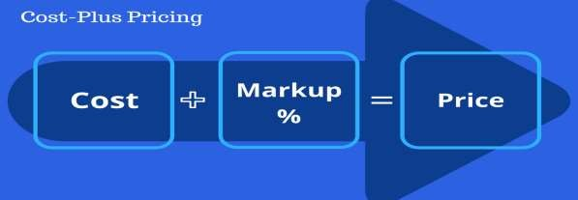
Cost Based Pricing strategy
🠶 Cost-based pricing is a pricing method that is based on the cost of production, manufacturing, and distribution. Essentially, the price of a product is determined by adding a percentage of the manufacturing costs to the selling price to make a profit. There are two types of cost-based pricing: cost-plus pricing and break-even pricing.

Slide 11
Market Based Pricing
🠶 Market-based pricing is when prices are set according to current market prices for the same or similar products. When done right, a market based pricing strategy allows a business to set prices higher when a product is initially introduced, and later on align prices with market prices to remain competitive.
Calculation of MBP
🠶 Calculating your market-based pricing goes as follows: You take the cost of your product, add the market factor price, and add a premium if you believe your product is driving that premium-worthy value. Market based pricing = cost of product + market factor price + premium
🠶 Market based pricing = cost of product + market factor price + premium

Slide 12
Competition-Based Pricing
🠶 Competitive-based pricing occurs when a company sets a price for its good based on what competitors are selling a similar product for.
Points to be considered
🠶 If competitors are pricing their products at a lower price, then it’s up to the company to either price their goods at a higher or lower price, all depending on what they want to achieve.
🠶 One advantage of competitive-based pricing is that it avoids price competition that can damage the company.
🠶 Potential disadvantages include that businesses may need to engage in other
tactics to engage customers (if the price is not enough of an incentive ).
🠶 Another concern for companies is that this pricing method may barely cover
production costs, resulting in low profits.
🠶 Another concern for companies is that this pricing method may only cover
production costs, resulting in low profits.

Slide 13
New product pricing Methods of pricing
🠶 1. Market Skimming Pricing:
🠶 Market skimming pricing strategy is a one where the firm initially charge high prices and skims the cream of market by concentrating on those segments of the market which are not price sensitive. The high initial price of the product helps in bringing back the revenues for the firm which can be further used by the firm. Later, on as product gets accepted and firm wants to enter mass market; it may lower down the price. For skimming strategy it is necessary that firm offers something distinctive in the product, worthy of its price, only then the product will be acceptable.

Slide 14
🠶 2. Market Penetration Pricing:
🠶 The market penetration pricing strategy is one where firm initially charges a low price for the product with the objective of the penetrating the market. When the firm sees that market available for the product is price sensitive, it has to fix a low price of the product. Low price brings changes in volume of sales and thereby more profits.
🠶 Penetration pricing is thus used when there is no segment in the market which is willing to pay any price for the product. At the same time, the product is such that it will face intense competition immediately when it is introduced in the market.

Slide 15
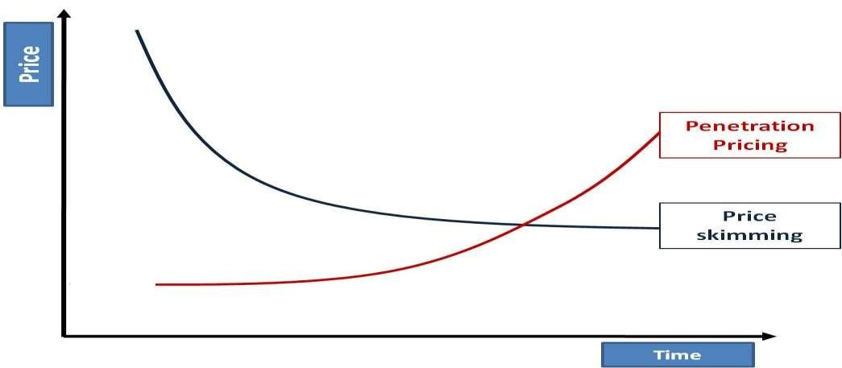
Strategies

Slide 16
What is Distribution Channel (Place)
🠶 Distribution Channel or Marketing Channel/ Trade Channel are sets of interdependent organisation involved in the Process of Making a Product or Service Available for use or Consumption.

Slide 17
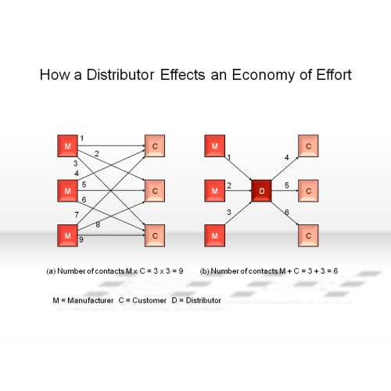

Slide 18
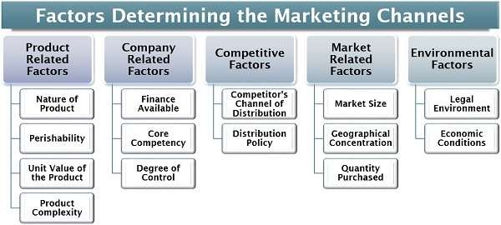

Slide 19
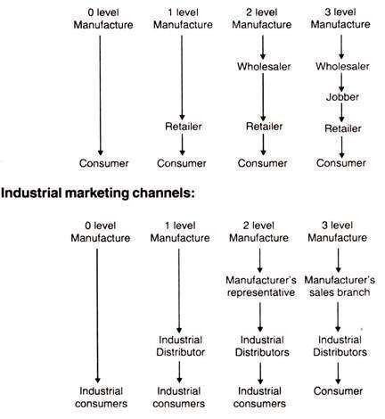

Slide 20
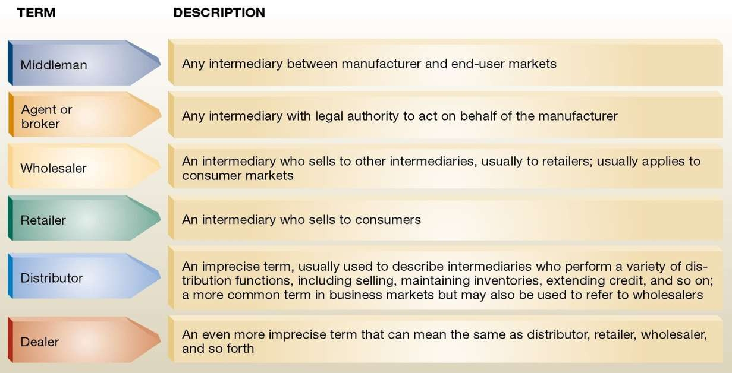

Slide 21
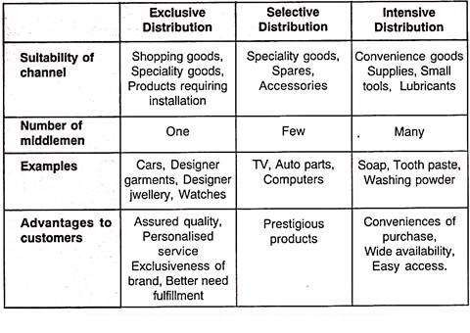

Slide 22
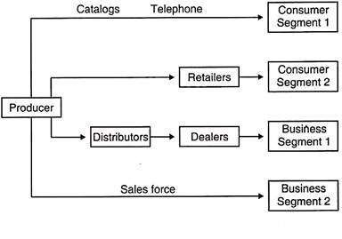

Slide 23
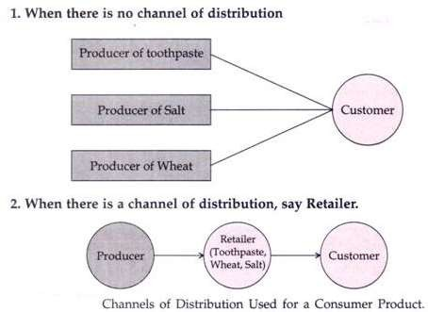

Slide 24
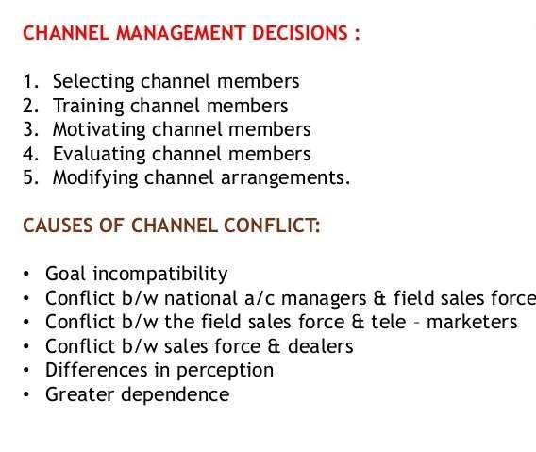

Slide 25
