Slide 1
Elasticity of Demand
Price, Income and Cross
MEANING AND TYPES
Dr. Bharti Shukla

Slide 2
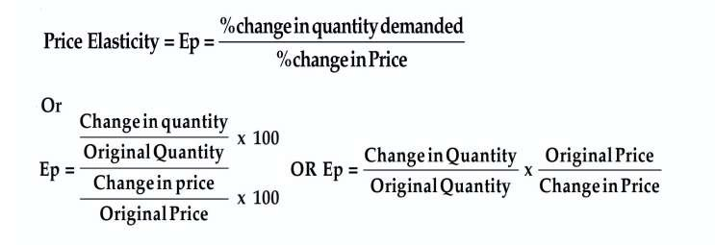
Price Elasticity
Price elasticity of demand is an economic measure of the change in the quantity demanded or purchased of a product in relation to its price change. Expressed mathematically, it is:

Slide 3
Types of Price Elasticity

Slide 4
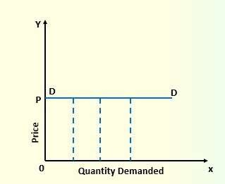
Perfect Price Elasticity
When there is approx no change or negligible change in price lead to infinite change in quantity demanded.
Price Zero,
change which
is Tending to lead to
infinite
change in Quantity.
So, Ep is also tending to infinite.

Slide 5
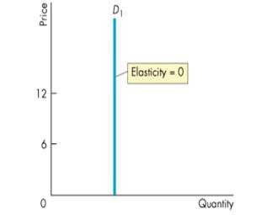
Perfect Price Inelasticity
When change in Price lead no change in quantity needed or demanded.
Price change is there, but no change in Quantity, i.e. Zero change.
So, Ep is also tending to zero.

Slide 6
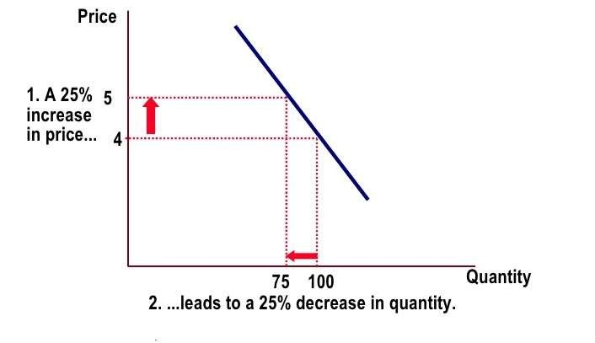
Unit Price Elasticity
When percentage or
in
proportionate change
price lead to same amount
of change in demanded.
Quantity
Here Ep=1

Slide 7
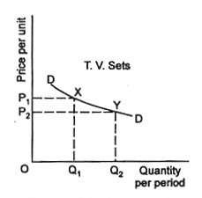
Elastic Demand or Relative Price Elasticity
When percentage or proportionate change in price lead to higher amount of change in Quantity demanded.
In this type of elasticity Ep is greater than one.
Ep>1

Slide 8
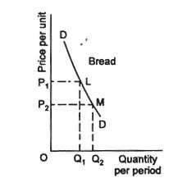
Inelastic Demand or Relative Price inelasticity
When percentage or proportionate change in price lead to less amount of change in Quantity demanded.
In this type of elasticity Ep is greater than one.
Ep<1

Slide 9
Practical Application
Effects of Changes in Price Upon Demand.
Effects of Changes in Price on Revenue.

Slide 10
Income Elasticity of Demand
Definition
Other things remaining same/ constant, it is degree of responsiveness of quantity demanded of a commodity due to change in consumer’s income.

Slide 11
In other words
Income Elasticity of Demand measures by how much the quantity demanded changes with respect to the change in income.

Slide 12
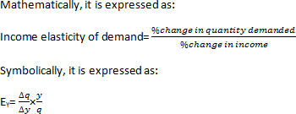
Mathematical Expression
Where,
E_{Y} = Elasticity of demand
q = Original quantity demanded
∆q = Change in quantity demanded y = Original consumer’s income
∆y = Change in consumer’s income

Slide 13
Practical Example
Suppose that the initial income of a person is Rs.2000 and quantity demanded for the commodity by him is 20 units.
When his income increases to Rs.3000, quantity demanded by him also increases to 40 units.
Find out the income elasticity of demand.

Slide 14
Solution
Here, q = 100 units
∆q = (40-20) units = 20 units y = Rs.2000
∆y = Rs. (3000-2000) =Rs.1000
Hence, an increase of Rs.1000 in income i.e. 1% in income leads to a rise of 2% in quantity demanded.

Slide 15
Types of Income Elasticity of demand
Positive income elasticity of demand (E_{Y}>0)
Income elasticity greater then unity (E_{Y} > 1)
Income elasticity equal to unity (E_{Y} = 1)
Income elasticity less then unity (E_{Y} < 1)
Negative income elasticity of demand ( E_{Y}<0)
Zero income elasticity of demand ( E_{Y}=0)

Slide 16
1. Positive income elasticity of demand (E_{Y}>0)
If the quantity demanded for a commodity increases with the rise in income of the consumer and vice versa, it is said to be positive income elasticity of demand.
For example:
As the income of consumer increases, they start consume more of superior (luxurious) goods.

Slide 17
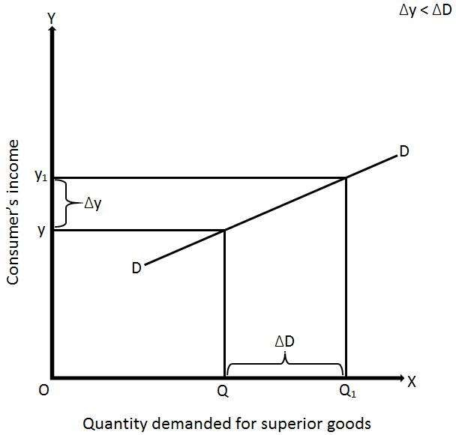
Income elasticity greater then unity (E_{Y} > 1)
Percentage change in quantity demanded for a commodity is greater than percentage change in income of the consumer, it is said to be income greater than unity

Slide 18
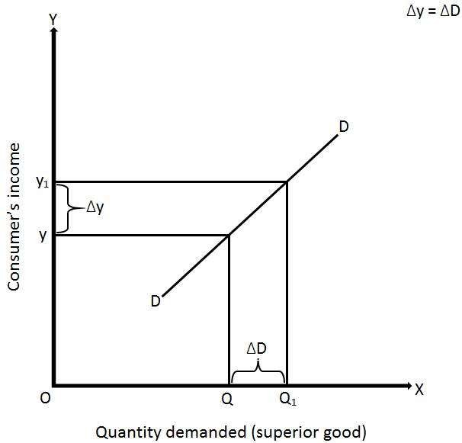
Income elasticity equal to unity (E_{Y} = 1)
Percentage change in quantity demanded for a commodity is equal to percentage change in income of the consumer

Slide 19
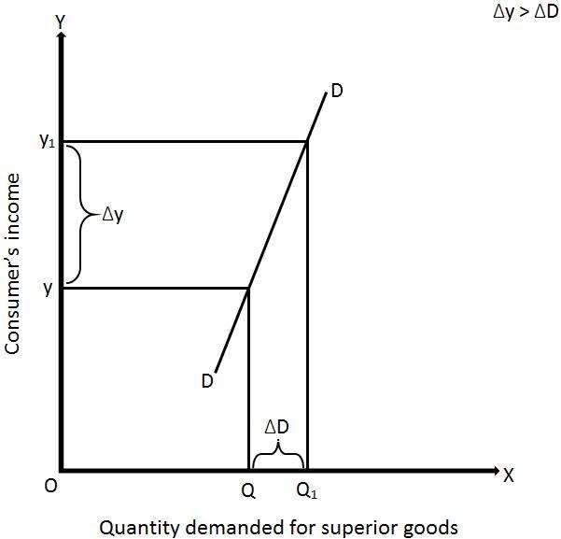
Income elasticity less then unity (E_{Y} < 1)
Percentage change in quantity demanded for a commodity is less than percentage change in income of the consumer

Slide 20
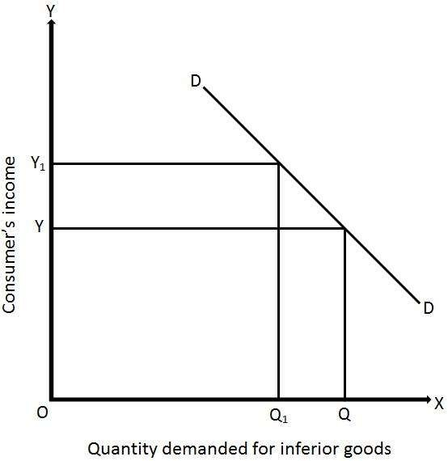
2. Negative income elasticity of demand ( E_{Y}<0)
Quantity demanded for a commodity decreases with the rise in income of the consumer and vice versa

Slide 21
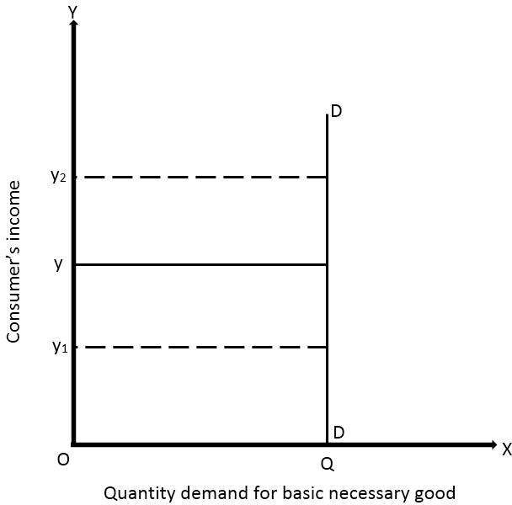
3. Zero income elasticity of demand ( E_{Y}=0)
Quantity demanded for a commodity remains constant with any rise or fall in income of the consumer

Slide 22
Cross Elasticity of Demand (CED)
Cross Price Elasticity (CED) measures the responsiveness of demand for good A following a change in the price of good B (a related good)
CED =
% change in quantity demanded of product A
% change in price of product B
With cross price elasticity we make an important distinction between substitute products and complementary goods and services.

Slide 23
Cross Elasticity of Demand (CED)
Substitutes
If price of one product increase, the demand for other substitute goods increases or vice versa, then The Cross Elasticity of Demand between the two substitutes is Positive.
Positive Effect on Other Good

Slide 24
Cross Elasticity of Demand (CED)
Complements
If price of one product increase, the demand for other Complementary goods decreases or vice versa, then The Cross Elasticity of Demand between the two Complementary is Negative.
Price effect is Negative.

Slide 25
Substitutes
Goods S and T are substitutes.
A rise in the price of Good S leads to rise in the demand for good T.
The cross price elasticity of demand will be positive.
Price of
Two Substitutes
Good S
Demand
P2
P1
Tea and Coffee,
WhatsApp and Telegram
Quantity demanded of
Good T

Slide 26
Complements
-
Goods X and Y are close complements
A fall in the price of good X leads to a large rise in the demand for good Y
The cross price elasticity of demand will be negative and the coefficient of elasticity will be more than one
Complements are said to be in JOINT DEMAND
Price of
Two Complements Demand
Good X
P1 P2
Petrol and Petrol car
Pen and Ink
Quantity demanded of
Good Y

Slide 27
Goods with zero cross-price elasticity of demand . INDEPENDENT
Price of
Demand
Goods A and B have no relationship.
A fall in the price of good A leads to no change in the demand for good B.
Therefore the cross-price elasticity of demand is zero.
Good A
P1
P2
Apples and salt!
P3
Quantity demanded of
Good B

Slide 28
Importance of CED for businesses
Firms can use CED estimates to predict: The impact of a rival’s pricing strategies on demand for their own products.
Pricing strategies for complementary goods: If firms have a reliable estimate for CED they can estimate the effect.

Slide 29
Applications of Cross Elasticity
Higher indirect taxes on goods such as tobacco – the impact on demand for nicotine patches and other substitutes
Rise in the price of natural gas – effect on the demand for coal used in power generation

