Slide 1
Dr. Bharti Shukla Assistant Professor MSD MMMUT, GKP
Topic to be covered
Utility
Cardinal Utility
Law of Diminishing Marginal Utility
Ordinal Utility
Indifference Curve Analysis

Slide 2
Consumer Theory
A consumer usually decides his demand for a commodity on the basis of utility (or satisfaction) that he derives from it. What is utility?
Utility of a commodity is its want-satisfying capacity. The more the need of a commodity or the stronger the desire to have it, the greater is the utility derived from the commodity.

Slide 3
About Utility
Utility is subjective. Different individuals can get different levels of utility from the same commodity.
For example, some one who likes chocolates will get much higher utility from a chocolate than some one who is not so fond of chocolates,
Also, utility that one individual gets from the commodity can change with change in place and time.
For example, utility from the use of a room heater will depend upon whether the individual is in Ladakh or Chennai (place) or whether it is summer or winter (time).

Slide 4
Features
Subjective
It is relative
Does not state usefulness
No ethical, legal or moral connotations

Slide 5
Two Types of Utility

Slide 6
Cardinal utility
Cardinal utility analysis assumes that level of utility can be expressed in numbers. For example, we can measure the utility derived from a shirt and say, this shirt gives me 50 units of utility. Before discussing further, it will be useful to have a look at two important measures of utility.

Slide 7
Measurement of Utility
Total Utility: Total utility of a fixed quantity of a commodity (TU) is the total satisfaction derived from consuming the given amount of some commodity x. More of commodity x provides more satisfaction to the consumer. TU dependson the quantity of the commodity consumed. Therefore, TUn refers to total utility derived from consuming n units of a commodity x.
Marginal Utility: Marginal utility (MU) is the change in total utility due to consumption of one additional unit of a commodity. For example, suppose 4 bananas give us 28 units of total utility and 5 bananas give us 30 units of total utility. Clearly, consumption of the 5th banana has caused total utility to increase by 2 units (30 units minus 28 units). Therefore, marginal utility of the 5th banana is 2 units.
MU5 = TU5 – TU4 = 30 – 28 = 2

Slide 8
Values of marginal and total utility derived from consumption of various amounts of a commodity
Units | Total Utility | Marginal Utility
1 | 12 | 12
2 | 18 | 6
3 | 22 | 4
4 | 24 | 2
5 | 24 | 0
6 | 22 | -2

Slide 9
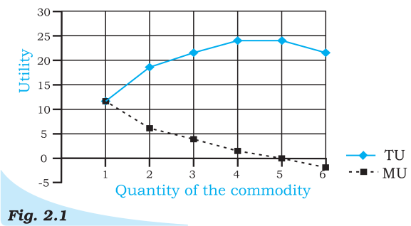
The values of marginal and total utility derived from consumption of various amounts of a commodity. The marginal utility diminishes with increase in consumption of the commodity.

Slide 10
Explanation of Utility Table and Diagram
Notice that MU3 is less than MU2. You may also notice that total utility increases but at a Diminishing rate: The rate of change in total utility due to change in quantity of commodity consumed is a measure of marginal utility. This marginal utility diminishes with increase in consumption of the commodity from 12 to 6, 6 to 4 and so on. This follows from the law of diminishing marginal utility.
MU becomes zero at a level when TU remains constant. In the example, TU does not change at 5th unit of consumption and therefore MU = 0. Thereafter, TU starts falling and MU becomes negative.

Slide 11
Law of Diminishing Marginal Utility
Law of Diminishing Marginal Utility states that marginal utility from consuming each additional unit of a commodity declines as its consumption increases, while keeping consumption of other commodities constant.

Slide 12
Assumptions
Units should be homogeneous
Consumed in quick succession
Standard in size
Taste should be constant
No change in price of substitute
Utility is measurable
Consumer is expected to be rational

Slide 13
Limitations
Dissimilar units
Too long an interval
Abnormal People
Rare Collection
Not Applicable to Money

